Slide 1
GREAT OUTDOORS (Group B)
By Arshpreet

Slide 2
EPIC AND USER STORIES
This section deal with mainly two things, namely View Overall Report and Update Discount:
View Overall Report:
Only admin has access to view the overall report.
Requires sales report and retailer report from Sales class and Retailer class.
The report is send every 15 days.
After evaluation, the report should tell if the expectations are me, not met or exceeded.
Update Discount:
Only admin has access to update discount.
This discount pertains to the Retailer class.
The discount should not exceed 20 % of cost savings.
The discount is proportional to the fact if targets are being met, not met or exceeded.

Slide 3
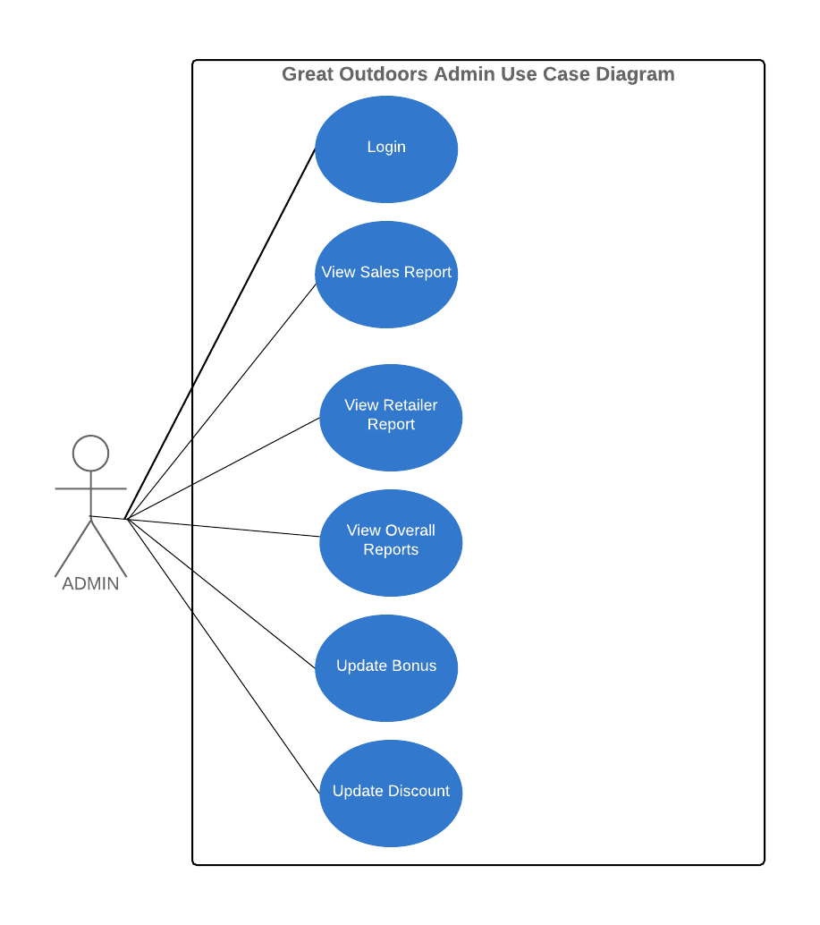
USE CASE DIAGRAM

Slide 4
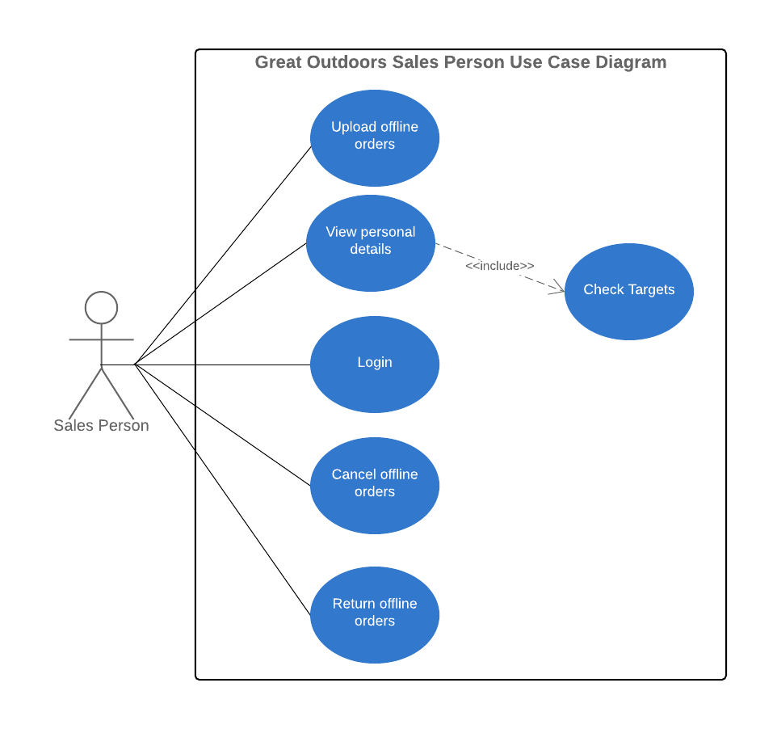
USE CASE DIAGRAM

Slide 5
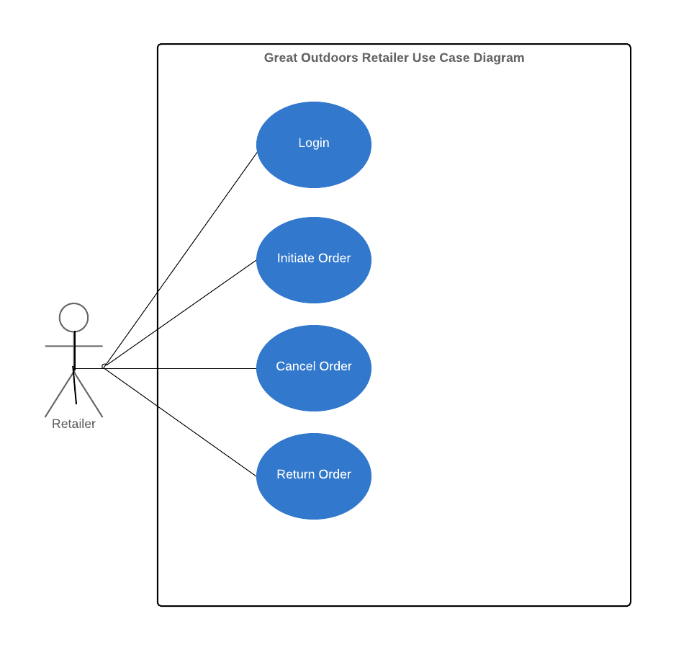
USE CASE DIAGRAM

Slide 6
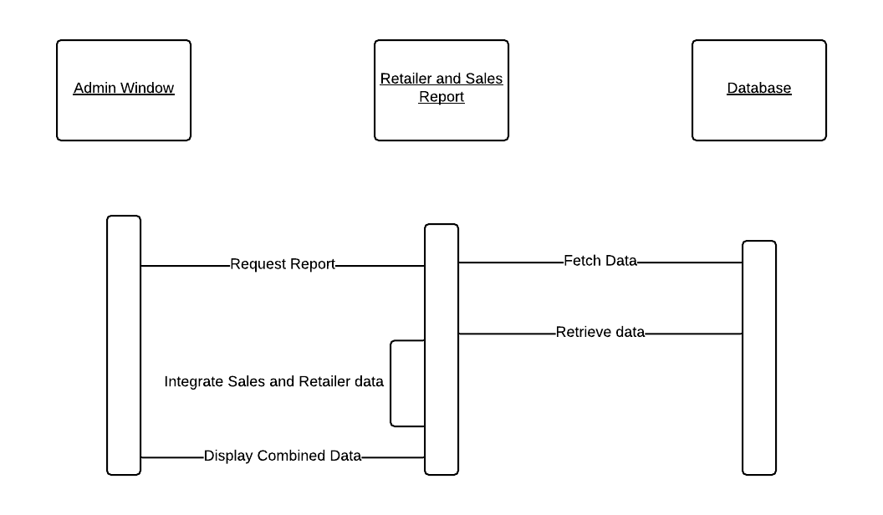
SEQUENCE DIAGRAM : OVERALL REPORT

Slide 7
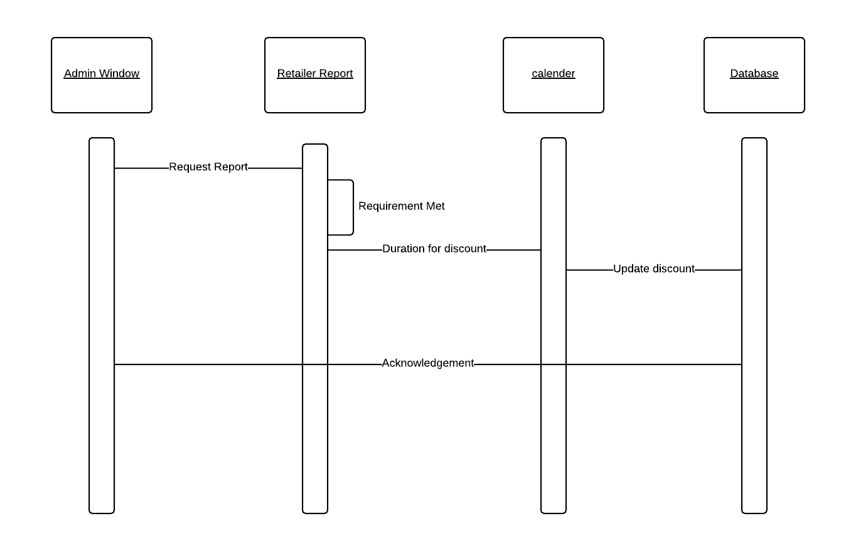
SEQUENCE DIAGRAM : UPDATE DISCOUNT

Slide 8
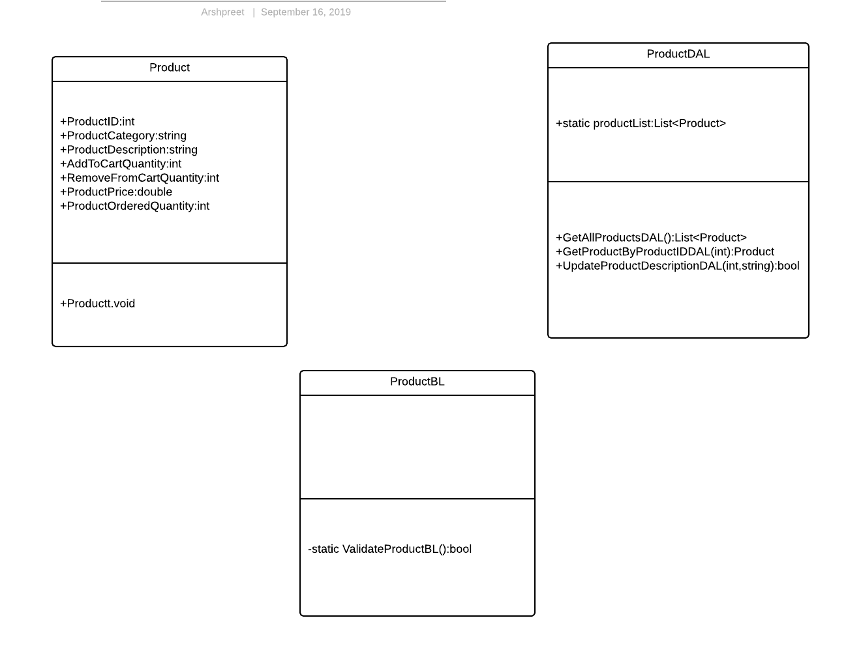
CLASS DIAGRAM (PRODUCT CLASS)

